Slide 1
CSE470: Software Engineering
Design Pattern

Slide 2
What is Design Pattern
Design patterns represent the best practices used by experienced object-oriented software developers.
Design patterns are solutions to general problems that software developers faced during software development.
These solutions were obtained by trial and error by numerous software developers over quite a substantial period of time.

Slide 3
What is Gang of Four (GOF)
In 1994, four authors Erich Gamma, Richard Helm, Ralph Johnson and John Vlissides published a book titled Design Patterns - Elements of Reusable Object-Oriented Software which initiated the concept of Design Pattern in Software development.
These authors are collectively known as Gang of Four (GOF). According to these authors design patterns are primarily based on the following principles of object oriented design.
Program to an interface not an implementation
Favor object composition over inheritance

Slide 4
Usage of Design Pattern
Design Patterns have two main usages in software development.
Common platform for developers
Design patterns provide a standard terminology and are specific to particular scenario. For example, a singleton design pattern signifies use of single object so all developers familiar with single design pattern will make use of single object and they can tell each other that program is following a singleton pattern.
Best Practices
Design patterns have been evolved over a long period of time and they provide best solutions to certain problems faced during software development. Learning these patterns helps inexperienced developers to learn software design in an easy and faster way.

Slide 5
Types of Design Patterns
As per the design pattern reference book Design Patterns - Elements of Reusable Object-Oriented Software, there are 23 design patterns which can be classified in three categories:
Creational
Structural
Behavioral

Slide 6
Creational
Talks about object creations.
To make design more readable and less complex.
Talks about efficiently object creation.
Example: Singleton Pattern

Slide 7
Structural
Talks about how classes and objects can be composed.
Parent-child relationship like inheritance used for structuring more than one classes.
Deals with simplicity in identifying relationships.
Example: Adapter Pattern

Slide 8
Behavioral
Deals with interactions and responsibility of objects.
Used for identifying and setting up common communication patterns among objects.
Example: Observer Pattern

Slide 9
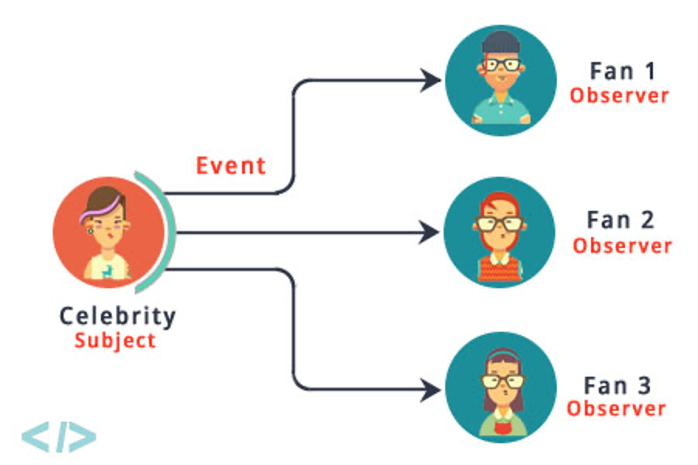
Observer Pattern
Intent: Define a one-to-many dependency between objects so that when one object change state, all its dependents are notified and updated automatically.

Slide 10
Participants
Subject: knows its observers. Any number of Observer objects may observe a subject. It sends a notification to its observers when its state changes. (ex: Celebrity)
Observer: defines an updating interface for objects that should be notified changes in a subject. (ex: Fans)
Concrete Subject: (ex: FilmCelebrity, FashionCelebrity)
Concrete Observer (ex: FilmFan, FashionFan)

Slide 11
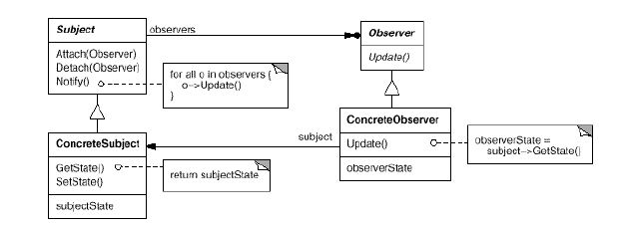
Structure

Slide 12
Observer Pattern
# driver code
teacher_fzn = Teacher(“FZN”)
student_ryan = Student(“Ryan”)
student_ryan.add_teacher(teacher_fzn)
Class Teacher:
def __init__(self, name):
self.students=[]
self.name=name
def attach_student(self, student):
self.students.append(student)
print(f”{student.name} has been attached to {self.name}”)
Class Student:
def__init__(self,name):
self.teachers=[]
self.name=name
def add_teachers(self,teacher):
self.teachers.append(teacher)
teacher.attach_student(self)

Slide 13
Fan-Celebrity Example
# Subject (Celebrity)
class Celebrity:
def __init__(self):
self._fans = []
self._state = None
def attach(self, fan):
self._fans.append(fan)
def detach(self, fan):
if fan in self.__fans:
self._fans.remove(fan)
def notify(self):
for fan in self._fans:
fan.update(self)
def set_state(self, state):
self._state = state
self._notify()
def get_state(self):
return self._state
# Observer (Fan)
class Fan:
def __init__(self):
self._celebrities = []
def update(self, celebrity):
state = celebrity.get_state()
def add_celebrity(self, celebrity):
self._celebrities.append(celebrity)
celebrity.attach(self)
def remove_celebrity(self, celebrity):
self._celebrities.remove(celebrity)
celebrity.detach(self)
#Driver Code
celebrity = Celebrity()
fan = Fan()
#fan starts following…
fan.add_celebrity(celebrity)
#celeb changes status and
#notification is received by fan
celebrity.set_state('New state')
#fan can stop following…
fan.remove_celebrity(celebrity)

Slide 14
Singleton Pattern
Intent: Ensure a class only has one instance, and provide a global point of access to it.
Motivation: The reason behind is
More than one instance will result in incorrect program behaviour.
More than one instance will result the overuse of resources.
Some classes should have only one instance throughout the system
Classification: Classified as one of the most known Creational Pattern

Slide 15
Singleton Pattern
Participants:
Singleton-defines an Instance operation that lets clients access its unique instance. Instance is a class operation .It may be responsible for creating its own unique instance. (ex: Singleton)

Slide 16
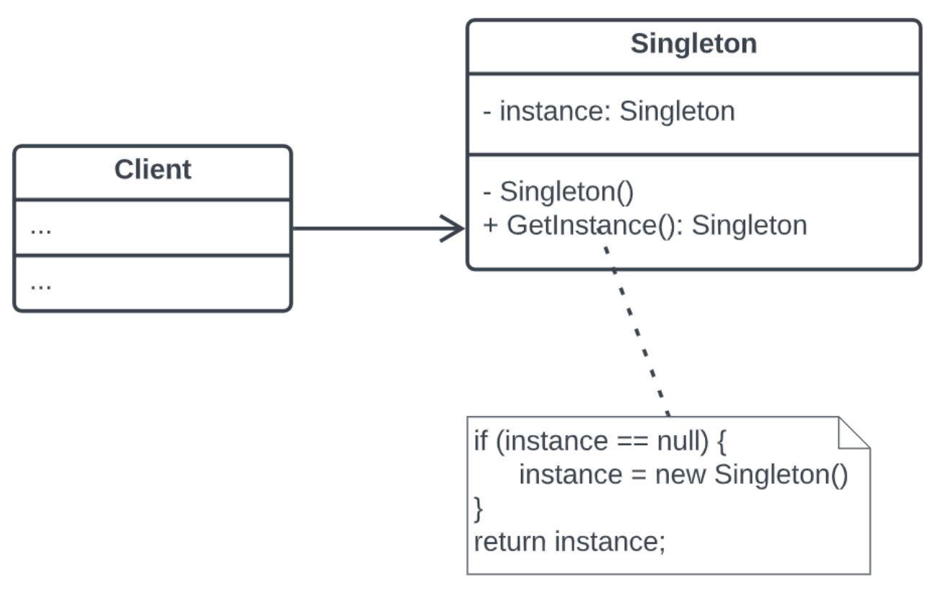
Singleton Structure

Slide 17
Singleton Pattern Example
class Singleton:
_instance = None
def __new__(cls):
if cls._instance is None:
print(' instance creating’)
cls._instance = super(Singleton, cls).__new__(cls) # return object reference or memory location
return cls._instance
# Driver Code
# Let's assume that multiple clients need the service
client1 = Singleton()
client2 = Singleton()
client3 = Singleton()
print(client1 is client2 is client3)
class Regular:
def __init__(self):
print(“new object created”)
Now imagine what will happen if we run the driver code for both Singleton and Regular classes

Slide 18
Why it works
Instantiation: __new__() is responsible for creating a new instance of the class. It allocates memory and prepares the object.
Initialization: After __new__() returns the new instance, the __init__() method is called to initialize the object’s state.
class MyClass:
def __new__(cls, *args, **kwargs):
instance = super(MyClass, cls).__new__(cls)
print("Instance created")
return instance
def __init__(self, value):
self.value = value
print("Instance initialized")
#Driver Code
obj = MyClass(10)
#Output:
Instance created
Instance initialized

Slide 19
Lazy Instance
Singleton make use of lazy initiation of the class. It means that its creation is deferred until it is first used. It helps to improve performance, avoid wasteful computation and reduce program memory requirement.
if(singleInstance == null){
singleInstance = new Singleton(); // Lazy initialization
}
Read more HERE

Slide 20
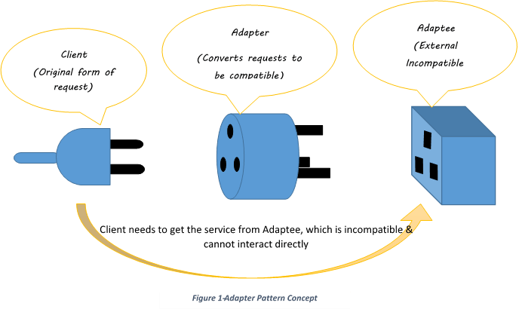
Adapter Pattern
In the real world...

Slide 21
Adapter Pattern
Participants:
Target: defines the domain-specific interface that Client uses. (ex: Pizza)
Client: collaborates with objects conforming to the Target interface.
Adaptee: defines an existing class that needs adapting (ex: ChittagongPizza)
Adapter: adapts the interface of Adaptee to the Target interface. (ex: ChittagongClassAdapter)

Slide 22

Scenario
Scenario: I have a pizza making store that creates different pizzas based on the choices of people of different locations. For example – people of Dhaka like DhakaStylePizza, people of Sylhet like SylhetStylePizza.
Solution: To meet the scenario, we can declare a Pizza interface and different location people can make their own style pizza by implementing the same interface.

Slide 23
Adapter Pattern Example
from abc import ABC, abstractmethod
# Target Interface (Pizza interface)
class Pizza(ABC):
@abstractmethod
def toppings(self):
pass
@abstractmethod
def buns(self):
pass
# Adaptee: DhakaiyaPizza
class DhakaiyaPizza:
def dhakaiya_toppings(self):
print("Adding Dhakaiya special toppings")
def dhakaiya_buns(self):
print("Preparing Dhakaiya style buns")
# Adaptee: ChittagongPizza
class ChittagongPizza:
def ctg_toppings(self):
print("Adding Chatgaiya special toppings")
def ctg_buns(self):
print("Preparing Chatgaiya style buns")

Slide 24
Adapter Pattern Example
from abc import ABC, abstractmethod
# Target Interface (Pizza interface)
class Pizza(ABC):
@abstractmethod
def toppings(self):
pass
@abstractmethod
def buns(self):
pass
# Adapter:
class PizzaClassAdapter(Pizza, DhakaiyaPizza):
def toppings(self):
self.dhakaiya_toppings()
def buns(self):
self.dhakaiya_buns()
# Adapter:
class PizzaClassAdapter(Pizza, ChittagongPizza):
def toppings(self):
self.ctg_toppings()
def buns(self):
self.ctg_buns()

Slide 25
Adapter Pattern
Adapter pattern can be solved in one of two ways:
Class Adapter: uses inheritance and can only wrap a class. It cannot wrap an interface since by definition it must derive from some base class
Object Adapter: uses composition and can wrap classes or interfaces, or both. It can do this since it contains, as a private, encapsulated member, the class or interface object instance it wraps.

Slide 26
Class Adapter Pattern
# Target Interface (Pizza interface)
class Pizza(ABC):
@abstractmethod
def toppings(self):
pass
@abstractmethod
def buns(self):
pass
class DhakaClassAdapter(Pizza, DhakaiyaPizza):
def toppings(self):
self.dhakaiya_toppings()
def buns(self):
self.dhakaiya_buns()
We want to adapt the existing DhakaiyaPizza, so it’s an Adaptee.
To do so, introduce a Class Adapter, DhakaClassAdapter
Customer use the adapter to adapt to the adaptee.

Slide 27
Object Adapter Pattern
# Target Interface (Pizza interface)
class Pizza(ABC):
@abstractmethod
def toppings(self):
pass
@abstractmethod
def buns(self):
pass
#Adapter
class DhakaObjectAdapter(Pizza):
def __init__(self, adaptee): # ---, dhk
self.adaptee = adaptee
def toppings(self):
self.adaptee.dhakaiya_toppings() #dhk.----
def buns(self):
self.adaptee.dhakaiya_buns()
#driver code
dhakaiya_adaptee = DhakaiyaPizza()
adapter_dhk=DhakaObjectAdapter(dhakaiya_adaptee )
adapter_dhk.toppings()
adapter_dhk.buns()
# Adaptee: DhakaiyaPizza
class DhakaiyaPizza:
def dhakaiya_toppings(self):
print("Adding Dhakaiya special toppings")
def dhakaiya_buns(self):
print("Preparing Dhakaiya style buns")

Slide 28
Useful Links
Python Coding Examples
Singleton Pattern
Observer Pattern
Adapter Pattern - 1
Adapter Pattern - 2
Adapter Pattern - 3

